Slide 1
Chapter 3: Introduction to SQL

Slide 2
Chapter 3: Introduction to SQL
Overview of The SQL Query Language
Data Definition
Basic Query Structure
Additional Basic Operations
Set Operations
Null Values
Aggregate Functions
Nested Subqueries
Modification of the Database
Notes:
1

Slide 3
History
IBM Sequel language developed as part of System R project at the IBM San Jose Research Laboratory
Renamed Structured Query Language (SQL)
ANSI and ISO standard SQL:
  SQL-86
  SQL-89
  SQL-92
  SQL:1999 (language name became Y2K compliant!)
  SQL:2003
Commercial systems offer most, if not all, SQL-92 features, plus varying feature sets from later standards and special proprietary features.
  Not all examples here may work on your particular system.

Slide 4
Domain Types in SQL
char(n). Fixed length character string, with user-specified length n.
varchar(n). Variable length character strings, with user-specified maximum length n.
int. Integer (a finite subset of the integers that is machine-dependent).
smallint. Small integer (a machine-dependent subset of the integer domain type).
numeric(p,d). Fixed point number, with user-specified precision of p digits, with n digits to the right of decimal point.
real, double precision. Floating point and double-precision floating point numbers, with machine-dependent precision.
float(n). Floating point number, with user-specified precision of at least n digits.
More are covered in Chapter 4.

Slide 5
Create Table Construct
An SQL relation is defined using the create table command:
create table r (A₁ D₁, A₂ D₂, ..., A_{n} D_{n},
(integrity-constraint₁),
...,
(integrity-constraint_{k}))
  r is the name of the relation
  each A_{i} is an attribute name in the schema of relation r
  D_{i} is the data type of values in the domain of attribute A_{i}
Example:
create table instructor (
ID char(5),
name varchar(20) not null,
dept_name varchar(20),
salary numeric(8,2))
insert into instructor values (‘10211’, ’Smith’, ’Biology’, 66000);
insert into instructor values (‘10211’, null, ’Biology’, 66000);

Slide 6
Integrity Constraints in Create Table
not null
primary key (A₁, ..., A_{n} )
foreign key (A_{m}, ..., A_{n} ) references r
Example: Declare branch_name as the primary key for branch
create table instructor (
ID char(5),
name varchar(20) not null,
dept_name varchar(20),
salary numeric(8,2),
primary key (ID),
foreign key (dept_name) references department)
primary key declaration on an attribute automatically ensures not null

Slide 7
And a Few More Relation Definitions
create table student (
ID varchar(5) primary key,
name varchar(20) not null,
dept_name varchar(20),
tot_cred numeric(3,0),
foreign key (dept_name) references department) );
create table takes (
ID varchar(5) primary key,
course_id varchar(8),
sec_id varchar(8),
semester varchar(6),
year numeric(4,0),
grade varchar(2),
foreign key (ID) references student,
foreign key (course_id, sec_id, semester, year) references section );

Slide 8
And more still
create table course (
course_id varchar(8) primary key,
title varchar(50),
dept_name varchar(20),
credits numeric(2,0),
foreign key (dept_name) references department) );

Slide 9
Drop and Alter Table Constructs
drop table
alter table
  alter table r add A D
    where A is the name of the attribute to be added to relation r and D is the domain of A.
    All tuples in the relation are assigned null as the value for the new attribute.
  alter table r drop A
    where A is the name of an attribute of relation r
    Dropping of attributes not supported by many databases.

Slide 10
Basic Query Structure
A typical SQL query has the form:
select A₁, A₂, ..., A_{n}
from r₁, r₂, ..., r_{m}
where P
  A_{i} represents an attribute
  R_{i} represents a relation
  P is a predicate.
The result of an SQL query is a relation.
Notes:
2

Slide 11
The select Clause
The select clause list the attributes desired in the result of a query
  corresponds to the projection operation of the relational algebra
Example: find the names of all instructors:
select name
from instructor
NOTE: SQL names are case insensitive (i.e., you may use upper- or lower-case letters.)
  E.g., Name ≡ NAME ≡ name
  Some people use upper case wherever we use bold font.
Notes:
3

Slide 12
The select Clause (Cont.)
SQL allows duplicates in relations as well as in query results.
To force the elimination of duplicates, insert the keyword distinct after select.
Find the names of all departments with instructor, and remove duplicates
select distinct dept_name
from instructor
The keyword all specifies that duplicates not be removed.
select all dept_name
from instructor
Notes:
4

Slide 13
The select Clause (Cont.)
An asterisk in the select clause denotes “all attributes”
select *
from instructor
The select clause can contain arithmetic expressions involving the operation, +, –, ∗, and /, and operating on constants or attributes of tuples.
The query:
select ID, name, salary/12
from instructor
would return a relation that is the same as the instructor relation, except that the value of the attribute salary is divided by 12.
Notes:
5

Slide 14
The where Clause
The where clause specifies conditions that the result must satisfy
  Corresponds to the selection predicate of the relational algebra.
To find all instructors in Comp. Sci. dept with salary > 80000
select name
from instructor
where dept_name = ‘Comp. Sci.' and salary > 80000
Comparison results can be combined using the logical connectives and, or, and not.
Comparisons can be applied to results of arithmetic expressions.
Notes:
6

Slide 15
The from Clause
The from clause lists the relations involved in the query
  Corresponds to the Cartesian product operation of the relational algebra.
Find the Cartesian product instructor X teaches
select ∗
from instructor, teaches
  generates every possible instructor – teaches pair, with all attributes from both relations.
Cartesian product not very useful directly, but useful combined with where-clause condition (selection operation in relational algebra).
Notes:
8

Slide 16


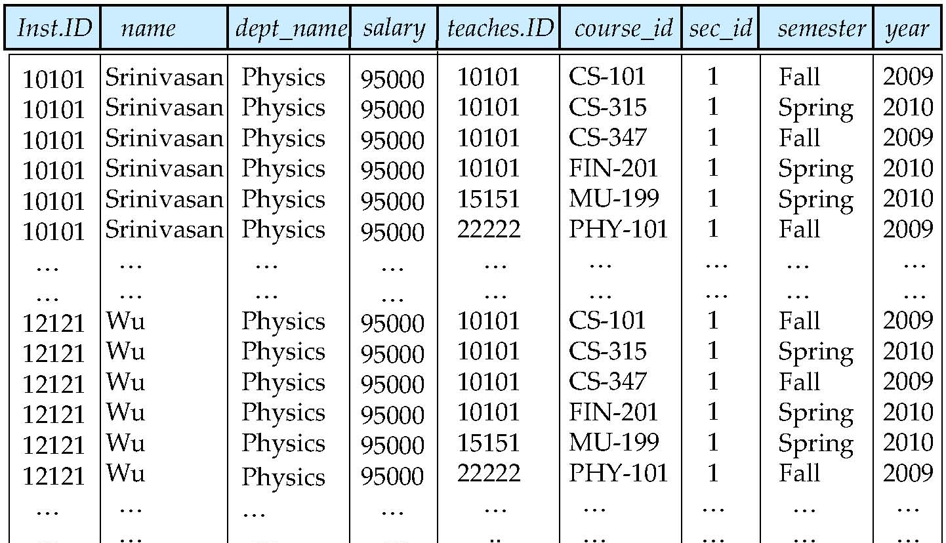
Cartesian Product
instructor
teaches

Slide 17
Joins
For all instructors who have taught courses, find their names and the course ID of the courses they taught.
select name, course_id
from instructor, teaches
where instructor.ID = teaches.ID
Find the course ID, semester, year and title of each course offered by the Comp. Sci. department
select section.course_id, semester, year, title
from section, course
where section.course_id = course.course_id and
dept_name = ‘Comp. Sci.'

Slide 18
Try Writing Some Queries in SQL
Suggest queries to be written…..

Slide 19

Natural Join
Natural join matches tuples with the same values for all common attributes, and retains only one copy of each common column
select *
from instructor natural join teaches;

Slide 20
Natural Join (Cont.)
Danger in natural join: beware of unrelated attributes with same name which get equated incorrectly
List the names of instructors along with the the titles of courses that they teach
Incorrect version (equates course.dept_name with instructor.dept_name)
  select name, title
  from instructor natural join teaches natural join course;
Correct version
  select name, title
  from instructor natural join teaches, course
  where teaches.course_id= course.course_id;
Another correct version
  select name, title
  from (instructor natural join teaches) join course using(course_id);

Slide 21
The Rename Operation
The SQL allows renaming relations and attributes using the as clause:
old-name as new-name
E.g.,
  select ID, name, salary/12 as monthly_salary
  from instructor
Find the names of all instructors who have a higher salary than
some instructor in ‘Comp. Sci’.
  select distinct T. name
  from instructor as T, instructor as S
  where T.salary > S.salary and S.dept_name = ‘Comp. Sci.’
Keyword as is optional and may be omitted
instructor as T ≡ instructor T
Notes:
9

Slide 22
String Operations
SQL includes a string-matching operator for comparisons on character strings. The operator “like” uses patterns that are described using two special characters:
  percent (%). The % character matches any substring.
  underscore (_). The _ character matches any character.
Find the names of all instructors whose name includes the substring “dar”.
select name
from instructor
where name like '%dar%'
Match the string “100 %”
like ‘100 \%' escape '\'
SQL supports a variety of string operations such as
  concatenation (using “||”)
  converting from upper to lower case (and vice versa)
  finding string length, extracting substrings, etc.

Slide 23
Ordering the Display of Tuples
List in alphabetic order the names of all instructors
select distinct name
from instructor
order by name
We may specify desc for descending order or asc for ascending order, for each attribute; ascending order is the default.
  Example: order by name desc
Can sort on multiple attributes
  Example: order by dept_name, name

Slide 24
Where Clause Predicates
SQL includes a between comparison operator
Example: Find the names of all instructors with salary between $90,000 and $100,000 (that is, ≥ $90,000 and ≤ $100,000)
  select name
  from instructor
  where salary between 90000 and 100000
Tuple comparison
  select name, course_id
  from instructor, teaches
  where (instructor.ID, dept_name) = (teaches.ID, ’Biology’);
Notes:
7

Slide 25
Duplicates
In relations with duplicates, SQL can define how many copies of tuples appear in the result.
Multiset versions of some of the relational algebra operators – given multiset relations r₁ and r₂:
  1. σ_{θ} (r₁): If there are c₁ copies of tuple t₁ in r₁, and t₁ satisfies selections σ_{θ,}, then there are c₁ copies of t₁ in σ_{θ} (r₁).
  2. Π_{A} (r ): For each copy of tuple t₁ in r₁, there is a copy of tuple Π_{A} (t₁) in Π_{A} (r₁) where Π_{A} (t₁) denotes the projection of the single tuple t₁.
  3. r₁ x r₂: If there are c₁ copies of tuple t₁ in r₁ and c₂ copies of tuple t₂ in r₂, there are c₁ x c₂ copies of the tuple t₁. t₂ in r₁ x r₂

Slide 26

Duplicates (Cont.)
Example: Suppose multiset relations r₁ (A, B) and r₂ (C) are as follows:
r₁ = {(1, a) (2,a)} r₂ = {(2), (3), (3)}
Then Π_{B}(r₁) would be {(a), (a)}, while Π_{B}(r₁) x r₂ would be
{(a,2), (a,2), (a,3), (a,3), (a,3), (a,3)}
SQL duplicate semantics:
select A₁,, A₂, ..., A_{n}
from r₁, r₂, ..., r_{m}
where P
is equivalent to the multiset version of the expression:

Slide 27
Set Operations
Find courses that ran in Fall 2009 or in Spring 2010
(select course_id from section where sem = ‘Fall’ and year = 2009)
union
(select course_id from section where sem = ‘Spring’ and year = 2010)
Find courses that ran in Fall 2009 and in Spring 2010
(select course_id from section where sem = ‘Fall’ and year = 2009)
intersect
(select course_id from section where sem = ‘Spring’ and year = 2010)
Find courses that ran in Fall 2009 but not in Spring 2010
(select course_id from section where sem = ‘Fall’ and year = 2009)
except
(select course_id from section where sem = ‘Spring’ and year = 2010)

Slide 28
Set Operations
Set operations union, intersect, and except
  Each of the above operations automatically eliminates duplicates
To retain all duplicates use the corresponding multiset versions union all, intersect all and except all.
Suppose a tuple occurs m times in r and n times in s, then, it occurs:
  m + n times in r union all s
  min(m,n) times in r intersect all s
  max(0, m – n) times in r except all s

Slide 29
Null Values
It is possible for tuples to have a null value, denoted by null, for some of their attributes
null signifies an unknown value or that a value does not exist.
The result of any arithmetic expression involving null is null
  Example: 5 + null returns null
The predicate is null can be used to check for null values.
  Example: Find all instructors whose salary is null.
select name
from instructor
where salary is null

Slide 30
Null Values and Three Valued Logic
Any comparison with null returns unknown
  Example: 5 < null or null <> null or null = null
Three-valued logic using the truth value unknown:
  OR: (unknown or true) = true,
  (unknown or false) = unknown
  (unknown or unknown) = unknown
  AND: (true and unknown) = unknown,
  (false and unknown) = false,
  (unknown and unknown) = unknown
  NOT: (not unknown) = unknown
  “P is unknown” evaluates to true if predicate P evaluates to unknown
Result of where clause predicate is treated as false if it evaluates to unknown

